Slide 1
Lecture 2: Image projection and Filtering
Book Ref.- Computer Vision, Szeliski : Section 2.1, especially Subsection 2.1.4

Slide 2
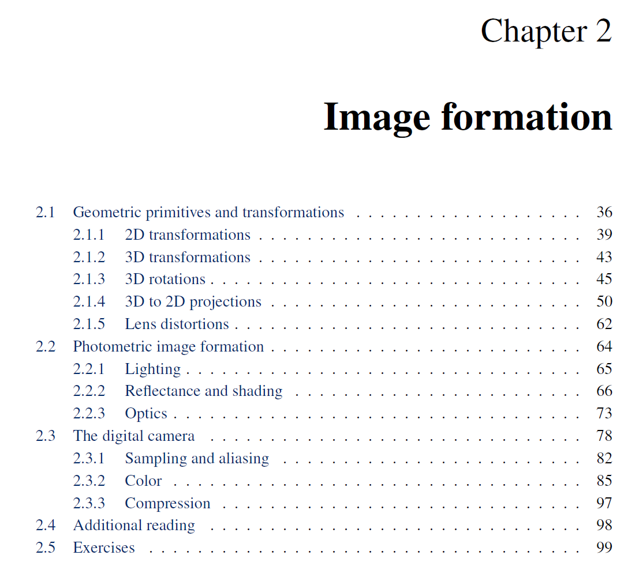

Slide 3
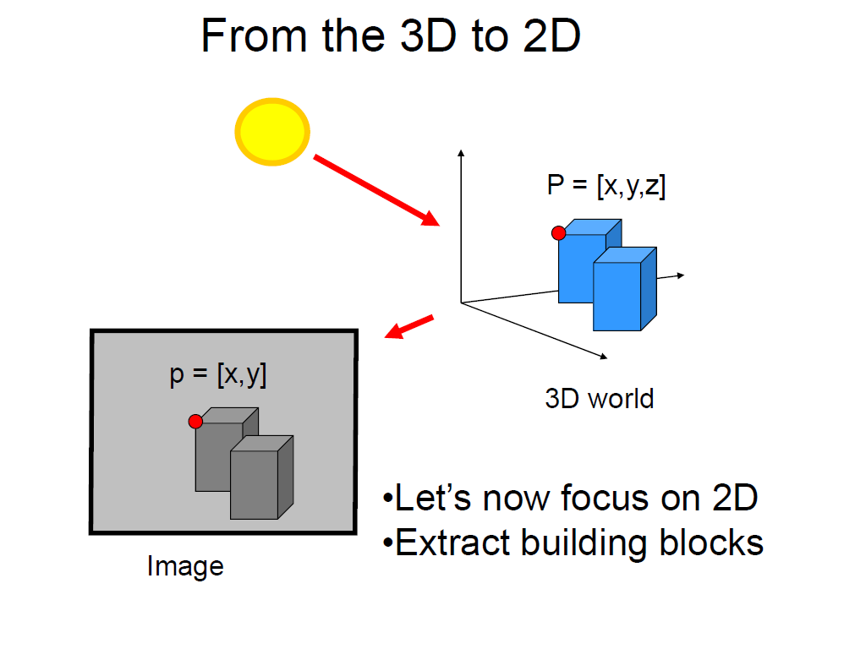
Slide credit Fei Fei Li

Slide 4
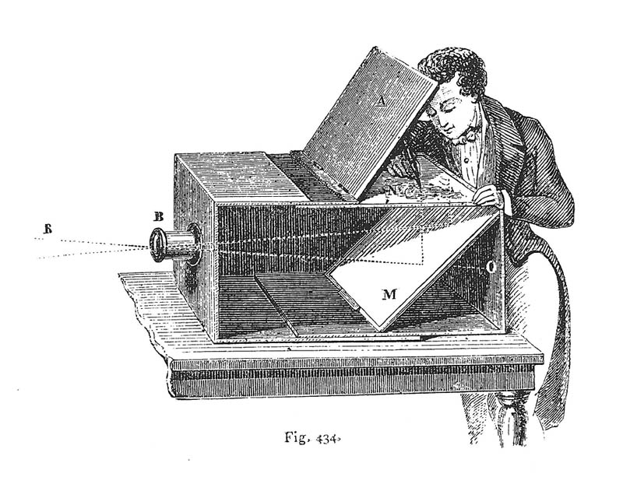
Camera Obscura used for Tracing
Lens Based Camera Obscura, 1568

Slide 5
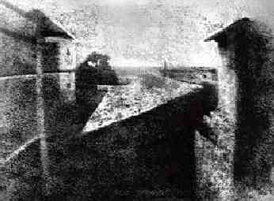
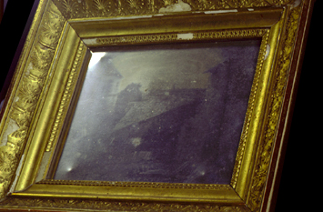
First Photograph
Oldest surviving photograph
Took 8 hours on pewter plate
Photograph of the first photograph
Joseph Niepce, 1826
Stored at UT Austin
Niepce later teamed up with Daguerre, who eventually created Daguerrotypes

Slide 6
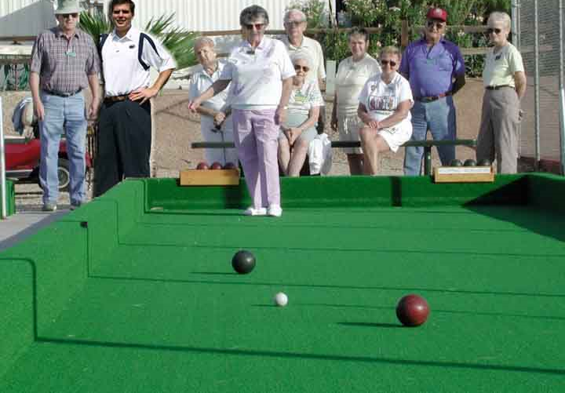
Projective Geometry
What is lost?
Length
Who is taller?
Which is closer?

Slide 7
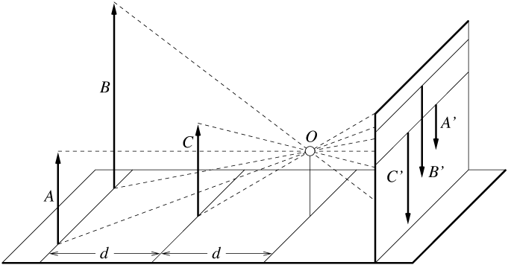
Length and area are not preserved
A’
C’
B’
Figure by David Forsyth

Slide 8
Projective Geometry
What is lost?
Length
Angles
Parallel?
Perpendicular?

Slide 9
Projective Geometry
What is preserved?
Straight lines are still straight

Slide 10
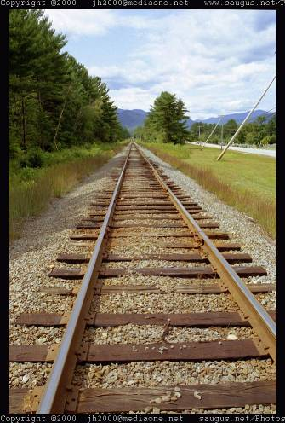
Vanishing points and lines
Parallel lines in the world intersect in the image at a “vanishing point”
Notes:
Go to board, sketch out various properties of vanishing points/lines

Slide 11
Vanishing points and lines
Vanishing Point
Vanishing Point
o
o
Vanishing Line
Notes:
Go to board, sketch out various properties of vanishing points/lines
Parallel lines intersect at a point
The intersection of red lines and blue lines form a parallelogram
Sets of parallel lines on the same plane form a vanishing line
Sets of parallel planes form a vanishing line
Not all lines that intersect are parallel

Slide 12
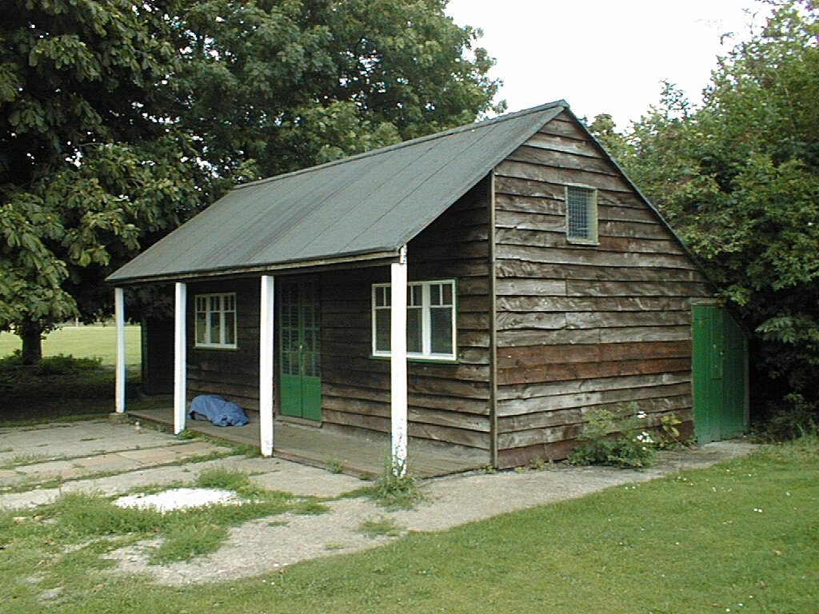
Vanishing points and lines
Vertical vanishing
point
(at infinity)
Vanishing
point
Vanishing
point
Slide from Efros, Photo from Criminisi

Slide 13
Projection: world coordinates→image coordinates
.
.
.
3
f
5
y
2
z
v’
?
.
Camera Center (0, 0, 0)
u’
If x = 2, y = 3, z = 5, and f = 2 What are u’ and v’?
Notes:
Being a little loose about coordinates vs lengths
u and v prime because they are in the same coordinate system as x, y, and z but in later slides u and v will be –u’ and –v’ because they are in their own coordinate system which is mirrored

Slide 14
Projection: world coordinates→image coordinates
.
Optical Center (u₀, v₀)
.
.
f
Z
Y
.
v
Camera Center (t_{x}, t_{y}, t_{z})
u
How do we handle the general case?

Slide 15
Interlude: why does this matter?

Slide 16
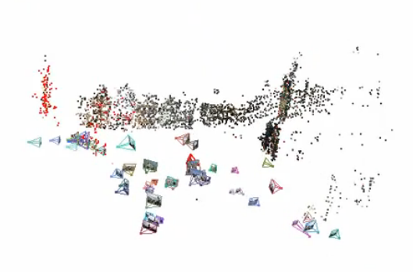
Relating multiple views

Slide 17


Slide 18
Projection: world coordinates→image coordinates
.
Optical Center (u₀, v₀)
.
.
f
Z
Y
.
v
Camera Center (t_{x}, t_{y}, t_{z})
u
How do we handle the general case?

Slide 19
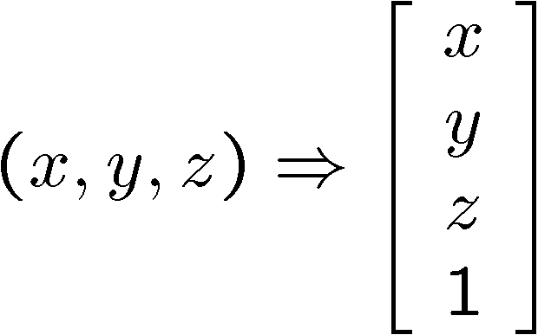
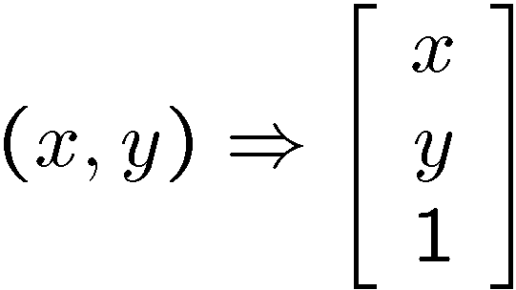
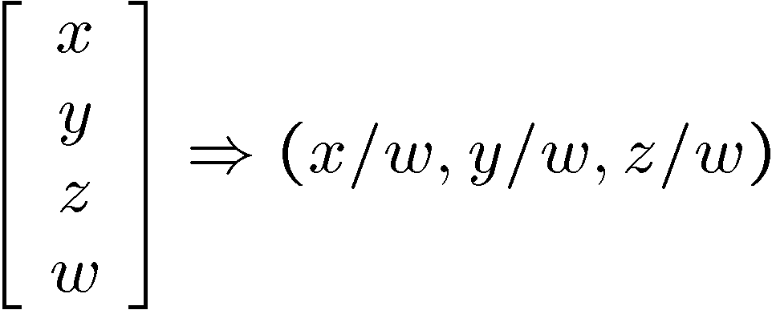
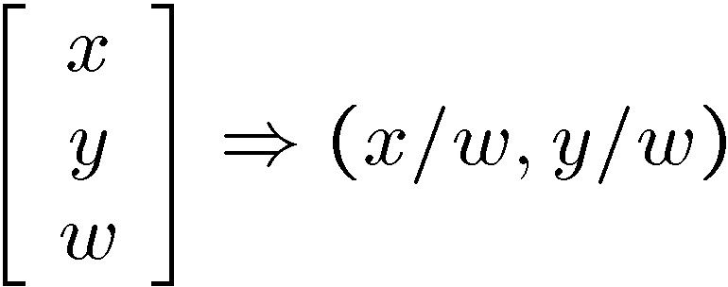
Homogeneous coordinates
Conversion
Converting to homogeneous coordinates
homogeneous image
coordinates
homogeneous scene
coordinates
Converting from homogeneous coordinates
Notes:
Append coordinate with value 1; proportional coordinate system

Slide 20
Homogeneous coordinates
Invariant to scaling
Point in Cartesian is ray in Homogeneous
Homogeneous Coordinates
Cartesian Coordinates
Notes:
Q: Suppose we have a point in Cartesian coordinates. What is that in homogeneous coordinates? A: a ray

Slide 21
Basic geometry in homogeneous coordinates
Line equation: ax + by + c = 0
Append 1 to pixel coordinate to get homogeneous coordinate
Line given by cross product of two points
Intersection of two lines given by cross product of the lines

Slide 22
Another problem solved by homogeneous coordinates
Intersection of parallel lines
Cartesian: (Inf, Inf)
Homogeneous: (1, 1, 0)
Cartesian: (Inf, Inf)
Homogeneous: (1, 2, 0)
Notes:
Parallel lines intersect at different infinities

Slide 23
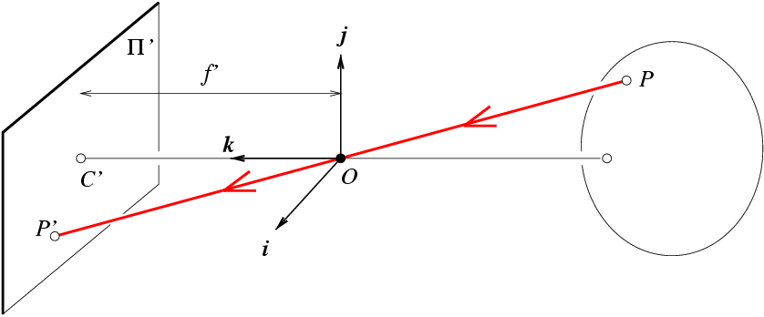
Projection matrix
Slide Credit: Savarese
R,t
j_{w}
X
k_{w}
O_{w}
x
i_{w}
x: Image Coordinates: (u,v,1)
K: Intrinsic Matrix (3x3)
R: Rotation (3x3)
t: Translation (3x1)
X: World Coordinates: (X,Y,Z,1)
Notes:
We can use homogeneous coordinates to write camera matrix in linear form.

Slide 24
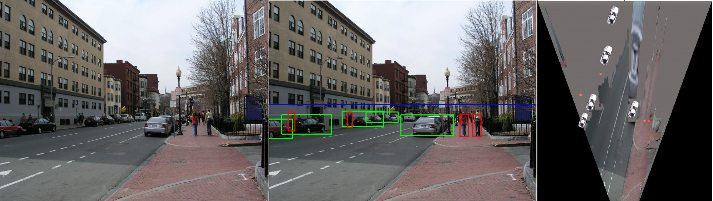
Object Recognition (CVPR 2006)

Slide 25
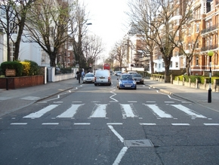
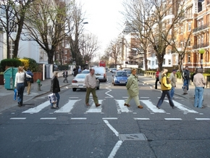
Inserting photographed objects into images (SIGGRAPH 2007)
Original
Created

Slide 26
Pinhole Camera Model
x: Image Coordinates: (u,v,1)
K: Intrinsic Matrix (3x3)
R: Rotation (3x3)
t: Translation (3x1)
X: World Coordinates: (X,Y,Z,1)

Slide 27
Projection matrix
X
x
Intrinsic Assumptions
Unit aspect ratio
Optical center at (0,0)
No skew
Extrinsic Assumptions
No rotation
Camera at (0,0,0)
K
Slide Credit: Savarese
Notes:
Work through equations for u and v on board

Slide 28
Projection matrix
X
x
Intrinsic Assumptions
Unit aspect ratio
Optical center at (0,0)
No skew
Extrinsic Assumptions
No rotation
Camera at (0,0,0)
Slide Credit: Savarese
Notes:
Work through equations for u and v on board

Slide 29
Remove assumption: known optical center
Intrinsic Assumptions
Unit aspect ratio
No skew
Extrinsic Assumptions
No rotation
Camera at (0,0,0)

Slide 30
Remove assumption: square pixels
Intrinsic Assumptions
No skew
Extrinsic Assumptions
No rotation
Camera at (0,0,0)

Slide 31
Remove assumption: non-skewed pixels
Intrinsic Assumptions
Extrinsic Assumptions
No rotation
Camera at (0,0,0)
Note: different books use different notation for parameters

Slide 32
Oriented and Translated Camera
R
j_{w}
X
t
k_{w}
O_{w}
x
i_{w}

Slide 33
Allow camera translation
Intrinsic Assumptions
Extrinsic Assumptions
No rotation

Slide 34
3D Rotation of Points
Slide Credit: Saverese
Rotation around the coordinate axes, counter-clockwise:
p’
γ
y
p
z

Slide 35
Allow camera rotation

Slide 36
Degrees of freedom
5
6
Notes:
How many known points are needed to estimate this?

Slide 37
Vanishing Point = Projection from Infinity

Slide 38
Orthographic Projection
Special case of perspective projection
Distance from the COP to the image plane is infinite
Also called “parallel projection”
What’s the projection matrix?
Image
World
Slide by Steve Seitz

Slide 39
Scaled Orthographic Projection
Special case of perspective projection
Object dimensions are small compared to distance to camera
Also called “weak perspective”
What’s the projection matrix?
Image
World
Slide by Steve Seitz

Slide 40
Field of View (Zoom, focal length)

Slide 41
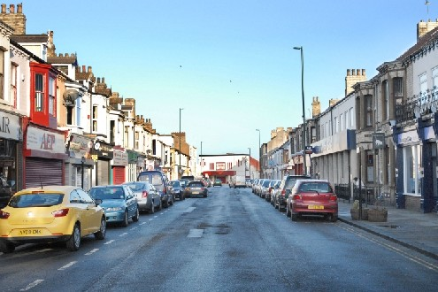
Suppose we have two 3D cubes on the ground facing the viewer, one near, one far.
What would they look like in perspective?
What would they look like in weak perspective?
Photo credit: GazetteLive.co.uk

Slide 42
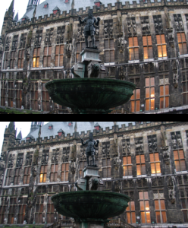
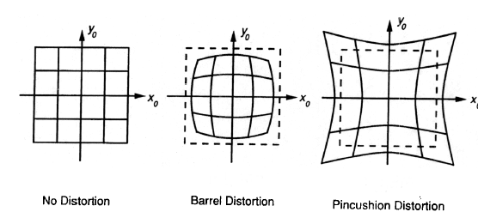
Beyond Pinholes: Radial Distortion
Corrected Barrel Distortion
Image from Martin Habbecke

Slide 43
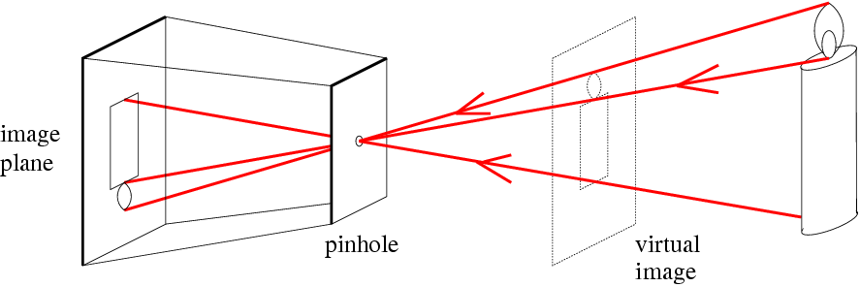
Things to remember
Vertical vanishing
point
(at infinity)
Vanishing points and vanishing lines
Pinhole camera model and camera projection matrix
Homogeneous coordinates
Vanishing
line
Vanishing
point
Vanishing
point

Slide 44
Reminder: read your book
Lectures have assigned readings
Szeliski 2.1 and especially 2.1.4 cover the geometry of image formation

Slide 45
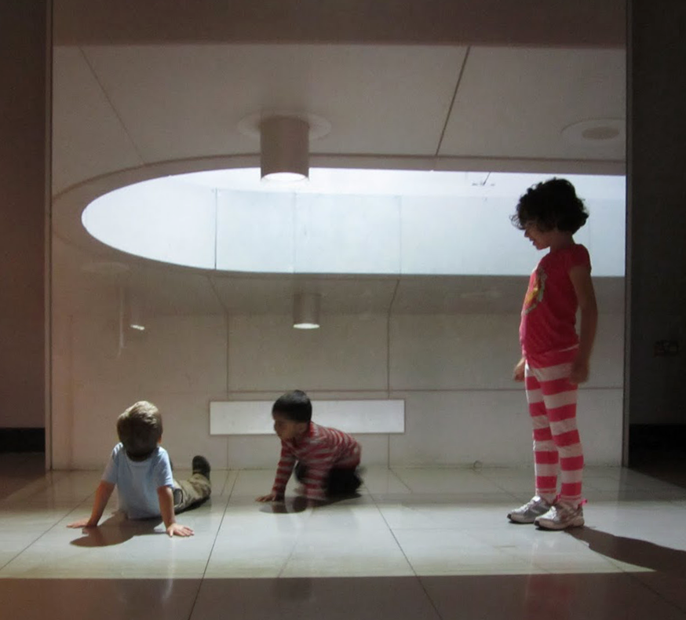
Image Filtering
Computer Vision
James Hays
Many slides by Derek Hoiem

Slide 46
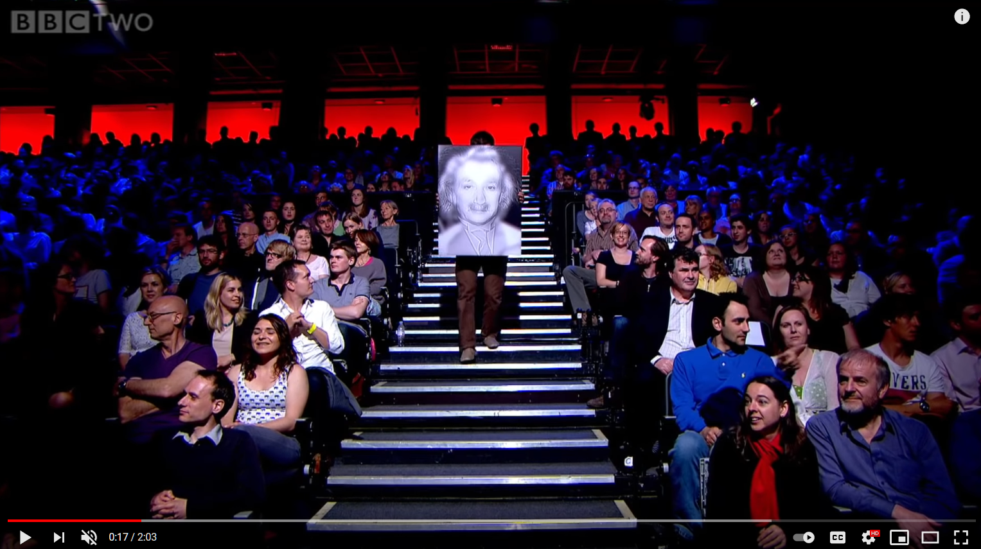
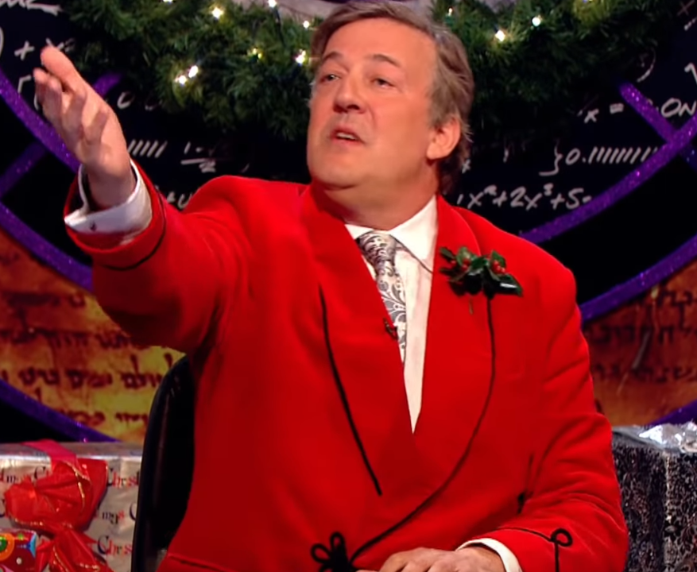
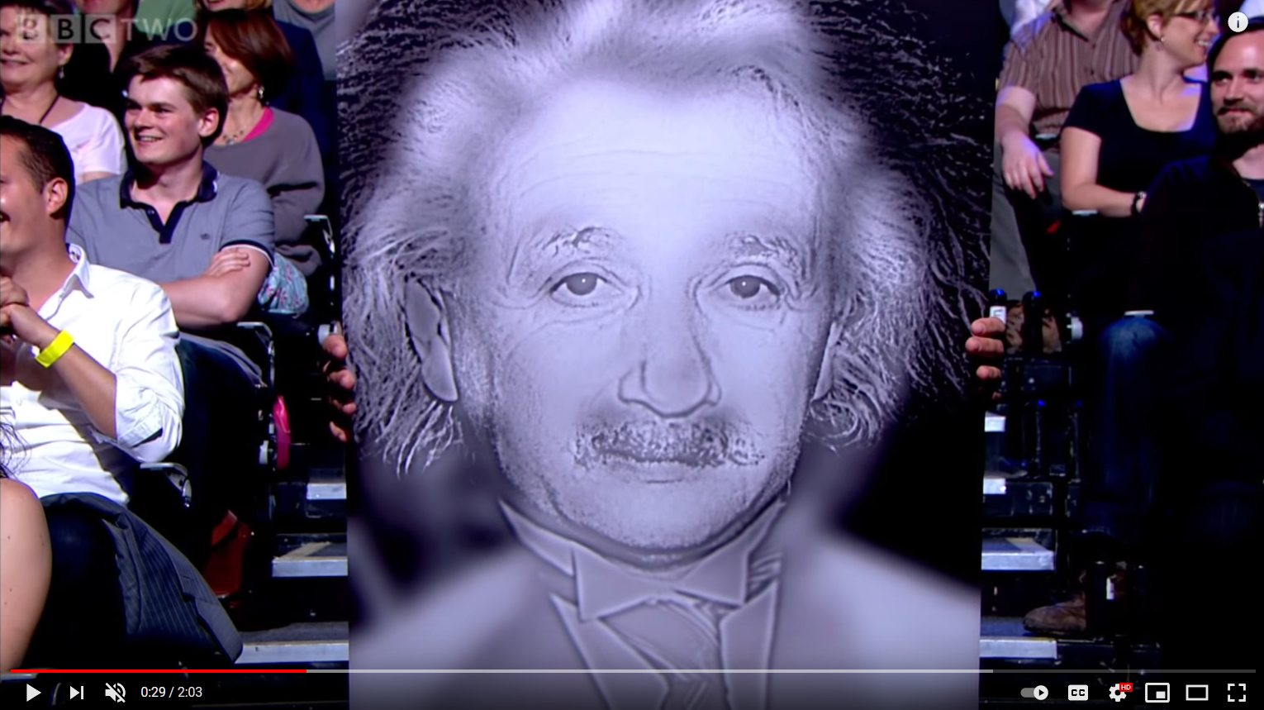
Project 1
BBC Clip: https://www.youtube.com/watch/OlumoQ05gS8

Slide 47
Slide credit Fei Fei Li

Slide 48
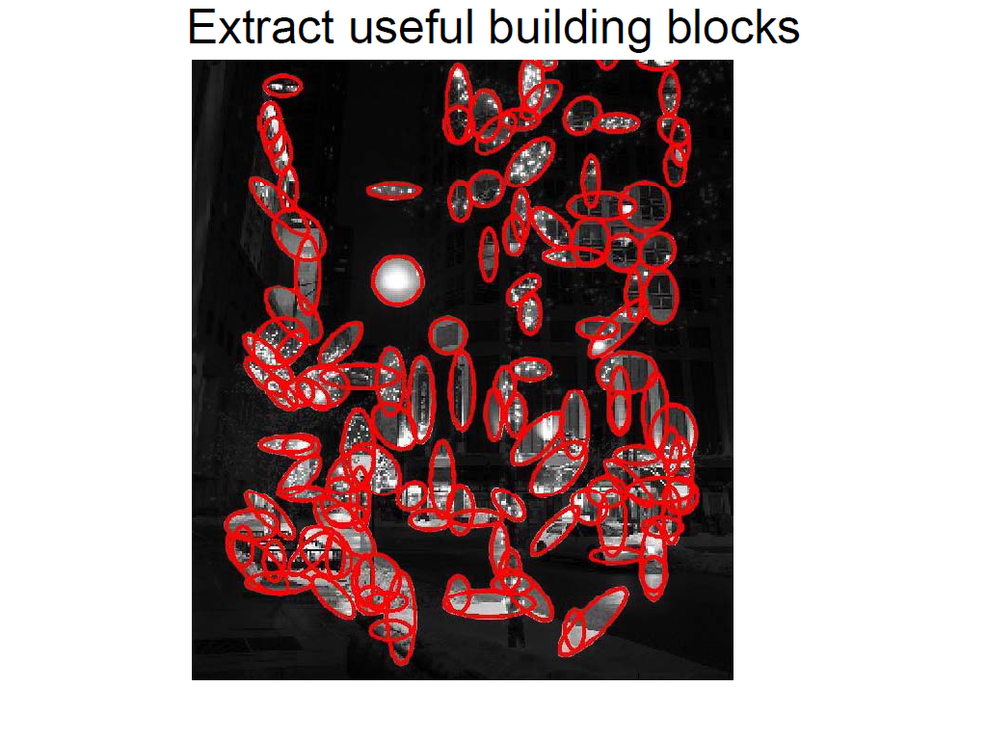
Slide credit Fei Fei Li

Slide 49
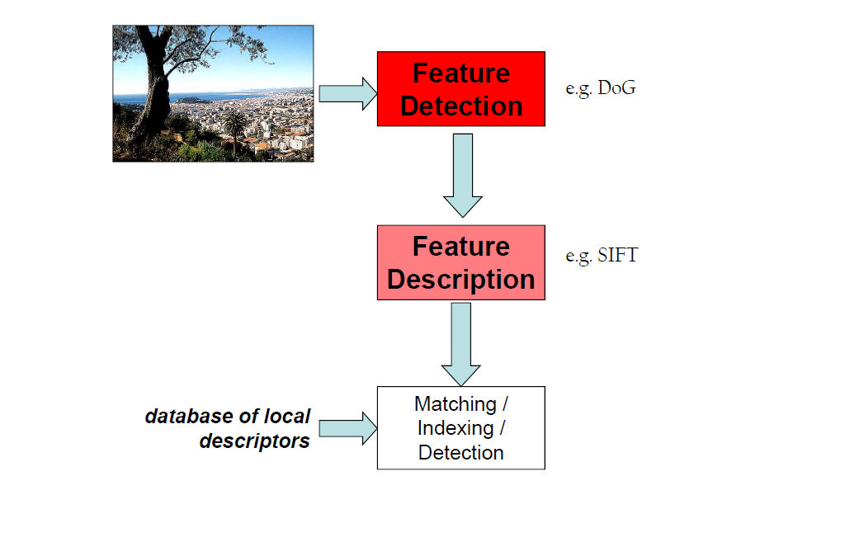
Slide credit Fei Fei Li

Slide 50
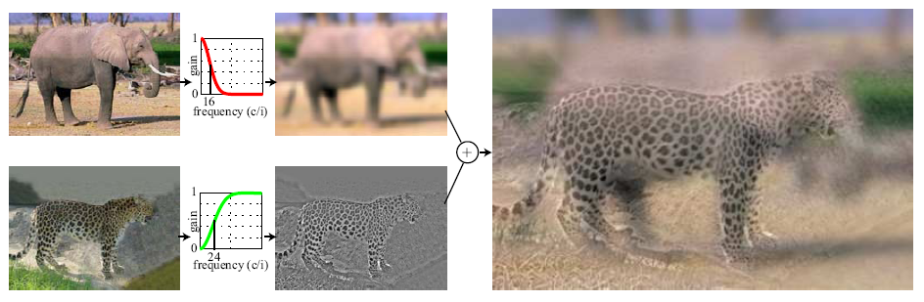
Hybrid Images
A. Oliva, A. Torralba, P.G. Schyns, “Hybrid Images,” SIGGRAPH 2006

Slide 51
Upcoming classes: two views of filtering
Image filters in spatial domain
Filter is a mathematical operation of a grid of numbers
Smoothing, sharpening, measuring texture
Image filters in the frequency domain
Filtering is a way to modify the frequencies of images
Denoising, sampling, image compression

Slide 52
Image filtering (or convolution)
Image filtering: compute function of local neighborhood at each position
Really important!
Enhance images
Denoise, resize, increase contrast, etc.
Extract information from images
Texture, edges, distinctive points, etc.
Detect patterns
Template matching
Deep Convolutional Networks

Slide 53

Example: box filter
1
1
1
1
1
1
1
1
1
Slide credit: David Lowe (UBC)

Slide 54
Image filtering
1
1
1
1
1
1
1
1
1
0 | 0 | 0 | 0 | 0 | 0 | 0 | 0 | 0 | 0
0 | 0 | 0 | 0 | 0 | 0 | 0 | 0 | 0 | 0
0 | 0 | 0 | 90 | 90 | 90 | 90 | 90 | 0 | 0
0 | 0 | 0 | 90 | 90 | 90 | 90 | 90 | 0 | 0
0 | 0 | 0 | 90 | 90 | 90 | 90 | 90 | 0 | 0
0 | 0 | 0 | 90 | 0 | 90 | 90 | 90 | 0 | 0
0 | 0 | 0 | 90 | 90 | 90 | 90 | 90 | 0 | 0
0 | 0 | 0 | 0 | 0 | 0 | 0 | 0 | 0 | 0
0 | 0 | 90 | 0 | 0 | 0 | 0 | 0 | 0 | 0
0 | 0 | 0 | 0 | 0 | 0 | 0 | 0 | 0 | 0
 | 0
0 | 0 | 0 | 0 | 0 | 0 | 0 | 0 | 0 | 0
0 | 0 | 0 | 0 | 0 | 0 | 0 | 0 | 0 | 0
0 | 0 | 0 | 90 | 90 | 90 | 90 | 90 | 0 | 0
0 | 0 | 0 | 90 | 90 | 90 | 90 | 90 | 0 | 0
0 | 0 | 0 | 90 | 90 | 90 | 90 | 90 | 0 | 0
0 | 0 | 0 | 90 | 0 | 90 | 90 | 90 | 0 | 0
0 | 0 | 0 | 90 | 90 | 90 | 90 | 90 | 0 | 0
0 | 0 | 0 | 0 | 0 | 0 | 0 | 0 | 0 | 0
0 | 0 | 90 | 0 | 0 | 0 | 0 | 0 | 0 | 0
0 | 0 | 0 | 0 | 0 | 0 | 0 | 0 | 0 | 0
Credit: S. Seitz
Notes:
ones, divide by 9

Slide 55
Image filtering
1
1
1
1
1
1
1
1
1
0 | 0 | 0 | 0 | 0 | 0 | 0 | 0 | 0 | 0
0 | 0 | 0 | 0 | 0 | 0 | 0 | 0 | 0 | 0
0 | 0 | 0 | 90 | 90 | 90 | 90 | 90 | 0 | 0
0 | 0 | 0 | 90 | 90 | 90 | 90 | 90 | 0 | 0
0 | 0 | 0 | 90 | 90 | 90 | 90 | 90 | 0 | 0
0 | 0 | 0 | 90 | 0 | 90 | 90 | 90 | 0 | 0
0 | 0 | 0 | 90 | 90 | 90 | 90 | 90 | 0 | 0
0 | 0 | 0 | 0 | 0 | 0 | 0 | 0 | 0 | 0
0 | 0 | 90 | 0 | 0 | 0 | 0 | 0 | 0 | 0
0 | 0 | 0 | 0 | 0 | 0 | 0 | 0 | 0 | 0
 | 0 | 10
0 | 0 | 0 | 0 | 0 | 0 | 0 | 0 | 0 | 0
0 | 0 | 0 | 0 | 0 | 0 | 0 | 0 | 0 | 0
0 | 0 | 0 | 90 | 90 | 90 | 90 | 90 | 0 | 0
0 | 0 | 0 | 90 | 90 | 90 | 90 | 90 | 0 | 0
0 | 0 | 0 | 90 | 90 | 90 | 90 | 90 | 0 | 0
0 | 0 | 0 | 90 | 0 | 90 | 90 | 90 | 0 | 0
0 | 0 | 0 | 90 | 90 | 90 | 90 | 90 | 0 | 0
0 | 0 | 0 | 0 | 0 | 0 | 0 | 0 | 0 | 0
0 | 0 | 90 | 0 | 0 | 0 | 0 | 0 | 0 | 0
0 | 0 | 0 | 0 | 0 | 0 | 0 | 0 | 0 | 0
Credit: S. Seitz
Notes:
ones, divide by 9

Slide 56
Image filtering
1
1
1
1
1
1
1
1
1
0 | 0 | 0 | 0 | 0 | 0 | 0 | 0 | 0 | 0
0 | 0 | 0 | 0 | 0 | 0 | 0 | 0 | 0 | 0
0 | 0 | 0 | 90 | 90 | 90 | 90 | 90 | 0 | 0
0 | 0 | 0 | 90 | 90 | 90 | 90 | 90 | 0 | 0
0 | 0 | 0 | 90 | 90 | 90 | 90 | 90 | 0 | 0
0 | 0 | 0 | 90 | 0 | 90 | 90 | 90 | 0 | 0
0 | 0 | 0 | 90 | 90 | 90 | 90 | 90 | 0 | 0
0 | 0 | 0 | 0 | 0 | 0 | 0 | 0 | 0 | 0
0 | 0 | 90 | 0 | 0 | 0 | 0 | 0 | 0 | 0
0 | 0 | 0 | 0 | 0 | 0 | 0 | 0 | 0 | 0
 | 0 | 10 | 20
0 | 0 | 0 | 0 | 0 | 0 | 0 | 0 | 0 | 0
0 | 0 | 0 | 0 | 0 | 0 | 0 | 0 | 0 | 0
0 | 0 | 0 | 90 | 90 | 90 | 90 | 90 | 0 | 0
0 | 0 | 0 | 90 | 90 | 90 | 90 | 90 | 0 | 0
0 | 0 | 0 | 90 | 90 | 90 | 90 | 90 | 0 | 0
0 | 0 | 0 | 90 | 0 | 90 | 90 | 90 | 0 | 0
0 | 0 | 0 | 90 | 90 | 90 | 90 | 90 | 0 | 0
0 | 0 | 0 | 0 | 0 | 0 | 0 | 0 | 0 | 0
0 | 0 | 90 | 0 | 0 | 0 | 0 | 0 | 0 | 0
0 | 0 | 0 | 0 | 0 | 0 | 0 | 0 | 0 | 0
Credit: S. Seitz
Notes:
ones, divide by 9

Slide 57
Image filtering
1
1
1
1
1
1
1
1
1
0 | 0 | 0 | 0 | 0 | 0 | 0 | 0 | 0 | 0
0 | 0 | 0 | 0 | 0 | 0 | 0 | 0 | 0 | 0
0 | 0 | 0 | 90 | 90 | 90 | 90 | 90 | 0 | 0
0 | 0 | 0 | 90 | 90 | 90 | 90 | 90 | 0 | 0
0 | 0 | 0 | 90 | 90 | 90 | 90 | 90 | 0 | 0
0 | 0 | 0 | 90 | 0 | 90 | 90 | 90 | 0 | 0
0 | 0 | 0 | 90 | 90 | 90 | 90 | 90 | 0 | 0
0 | 0 | 0 | 0 | 0 | 0 | 0 | 0 | 0 | 0
0 | 0 | 90 | 0 | 0 | 0 | 0 | 0 | 0 | 0
0 | 0 | 0 | 0 | 0 | 0 | 0 | 0 | 0 | 0
 | 0 | 10 | 20 | 30
0 | 0 | 0 | 0 | 0 | 0 | 0 | 0 | 0 | 0
0 | 0 | 0 | 0 | 0 | 0 | 0 | 0 | 0 | 0
0 | 0 | 0 | 90 | 90 | 90 | 90 | 90 | 0 | 0
0 | 0 | 0 | 90 | 90 | 90 | 90 | 90 | 0 | 0
0 | 0 | 0 | 90 | 90 | 90 | 90 | 90 | 0 | 0
0 | 0 | 0 | 90 | 0 | 90 | 90 | 90 | 0 | 0
0 | 0 | 0 | 90 | 90 | 90 | 90 | 90 | 0 | 0
0 | 0 | 0 | 0 | 0 | 0 | 0 | 0 | 0 | 0
0 | 0 | 90 | 0 | 0 | 0 | 0 | 0 | 0 | 0
0 | 0 | 0 | 0 | 0 | 0 | 0 | 0 | 0 | 0
Credit: S. Seitz
Notes:
ones, divide by 9

Slide 58
Image filtering
1
1
1
1
1
1
1
1
1
0 | 0 | 0 | 0 | 0 | 0 | 0 | 0 | 0 | 0
0 | 0 | 0 | 0 | 0 | 0 | 0 | 0 | 0 | 0
0 | 0 | 0 | 90 | 90 | 90 | 90 | 90 | 0 | 0
0 | 0 | 0 | 90 | 90 | 90 | 90 | 90 | 0 | 0
0 | 0 | 0 | 90 | 90 | 90 | 90 | 90 | 0 | 0
0 | 0 | 0 | 90 | 0 | 90 | 90 | 90 | 0 | 0
0 | 0 | 0 | 90 | 90 | 90 | 90 | 90 | 0 | 0
0 | 0 | 0 | 0 | 0 | 0 | 0 | 0 | 0 | 0
0 | 0 | 90 | 0 | 0 | 0 | 0 | 0 | 0 | 0
0 | 0 | 0 | 0 | 0 | 0 | 0 | 0 | 0 | 0
 | 0 | 10 | 20 | 30 | 30
Credit: S. Seitz
Notes:
ones, divide by 9

Slide 59
Image filtering
1
1
1
1
1
1
1
1
1
0 | 0 | 0 | 0 | 0 | 0 | 0 | 0 | 0 | 0
0 | 0 | 0 | 0 | 0 | 0 | 0 | 0 | 0 | 0
0 | 0 | 0 | 90 | 90 | 90 | 90 | 90 | 0 | 0
0 | 0 | 0 | 90 | 90 | 90 | 90 | 90 | 0 | 0
0 | 0 | 0 | 90 | 90 | 90 | 90 | 90 | 0 | 0
0 | 0 | 0 | 90 | 0 | 90 | 90 | 90 | 0 | 0
0 | 0 | 0 | 90 | 90 | 90 | 90 | 90 | 0 | 0
0 | 0 | 0 | 0 | 0 | 0 | 0 | 0 | 0 | 0
0 | 0 | 90 | 0 | 0 | 0 | 0 | 0 | 0 | 0
0 | 0 | 0 | 0 | 0 | 0 | 0 | 0 | 0 | 0
 | 0 | 10 | 20 | 30 | 30
?
Credit: S. Seitz
Notes:
ones, divide by 9

Slide 60
Image filtering
1
1
1
1
1
1
1
1
1
0 | 0 | 0 | 0 | 0 | 0 | 0 | 0 | 0 | 0
0 | 0 | 0 | 0 | 0 | 0 | 0 | 0 | 0 | 0
0 | 0 | 0 | 90 | 90 | 90 | 90 | 90 | 0 | 0
0 | 0 | 0 | 90 | 90 | 90 | 90 | 90 | 0 | 0
0 | 0 | 0 | 90 | 90 | 90 | 90 | 90 | 0 | 0
0 | 0 | 0 | 90 | 0 | 90 | 90 | 90 | 0 | 0
0 | 0 | 0 | 90 | 90 | 90 | 90 | 90 | 0 | 0
0 | 0 | 0 | 0 | 0 | 0 | 0 | 0 | 0 | 0
0 | 0 | 90 | 0 | 0 | 0 | 0 | 0 | 0 | 0
0 | 0 | 0 | 0 | 0 | 0 | 0 | 0 | 0 | 0
 | 0 | 10 | 20 | 30 | 30
 |  |  |  | 50
?
Credit: S. Seitz
Notes:
ones, divide by 9

Slide 61
Image filtering
1
1
1
1
1
1
1
1
1
0 | 0 | 0 | 0 | 0 | 0 | 0 | 0 | 0 | 0
0 | 0 | 0 | 0 | 0 | 0 | 0 | 0 | 0 | 0
0 | 0 | 0 | 90 | 90 | 90 | 90 | 90 | 0 | 0
0 | 0 | 0 | 90 | 90 | 90 | 90 | 90 | 0 | 0
0 | 0 | 0 | 90 | 90 | 90 | 90 | 90 | 0 | 0
0 | 0 | 0 | 90 | 0 | 90 | 90 | 90 | 0 | 0
0 | 0 | 0 | 90 | 90 | 90 | 90 | 90 | 0 | 0
0 | 0 | 0 | 0 | 0 | 0 | 0 | 0 | 0 | 0
0 | 0 | 90 | 0 | 0 | 0 | 0 | 0 | 0 | 0
0 | 0 | 0 | 0 | 0 | 0 | 0 | 0 | 0 | 0
 | 0 | 10 | 20 | 30 | 30 | 30 | 20 | 10
 | 0 | 20 | 40 | 60 | 60 | 60 | 40 | 20
 | 0 | 30 | 60 | 90 | 90 | 90 | 60 | 30
 | 0 | 30 | 50 | 80 | 80 | 90 | 60 | 30
 | 0 | 30 | 50 | 80 | 80 | 90 | 60 | 30
 | 0 | 20 | 30 | 50 | 50 | 60 | 40 | 20
 | 10 | 20 | 30 | 30 | 30 | 30 | 20 | 10
 | 10 | 10 | 10 | 0 | 0 | 0 | 0 | 0
Credit: S. Seitz

Slide 62
Box Filter
What does it do?
Replaces each pixel with an average of its neighborhood
Achieve smoothing effect (remove sharp features)
1
1
1
1
1
1
1
1
1
Slide credit: David Lowe (UBC)

Slide 63
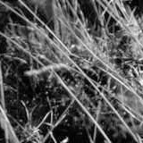
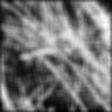
Smoothing with box filter

Slide 64
One more on board…

Slide 65
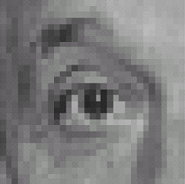
Practice with linear filters
0
0
0
?
0
1
0
0
0
0
Original
Source: D. Lowe

Slide 66
Practice with linear filters
0
0
0
0
1
0
0
0
0
Original
Filtered
(no change)
Source: D. Lowe

Slide 67
Practice with linear filters
0
0
0
?
0
0
1
0
0
0
Original
Source: D. Lowe

Slide 68
Practice with linear filters
0
0
0
0
0
1
0
0
0
Original
Shifted left
By 1 pixel
Source: D. Lowe

Slide 69

Practice with linear filters
0
0
0
-
1
1
1
?
0
2
0
1
1
1
0
0
0
1
1
1
(Note that filter sums to 1)
Original
Source: D. Lowe

Slide 70
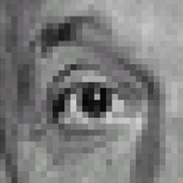
Practice with linear filters
0
0
0
-
1
1
1
0
2
0
1
1
1
0
0
0
1
1
1
Original
Sharpening filter
Accentuates differences with local average
Source: D. Lowe

Slide 71
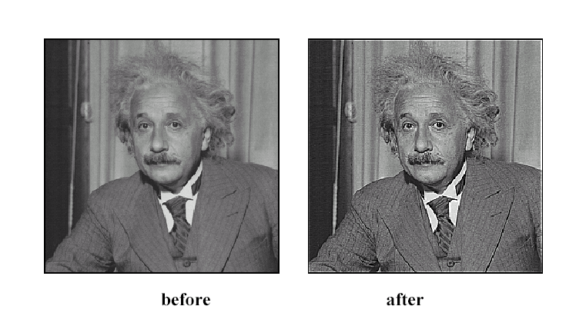
Sharpening
Source: D. Lowe

Slide 72
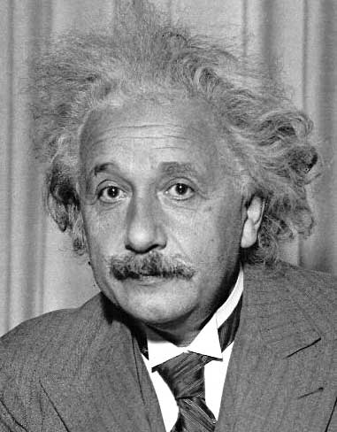
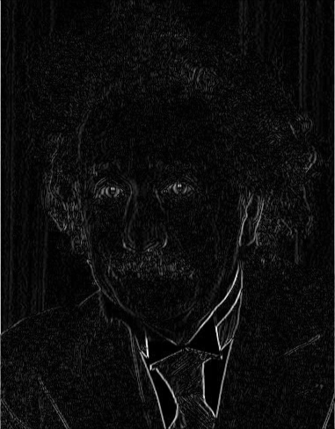
Other filters
1
0
-1
2
0
-2
1
0
-1
Sobel
Vertical Edge
(absolute value)

Slide 73
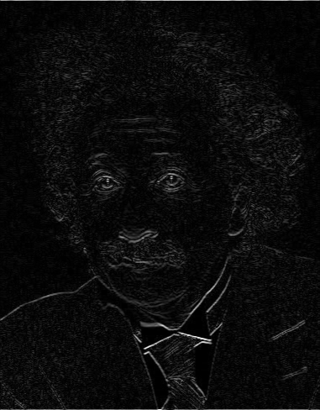
Other filters
1
2
1
0
0
0
-1
-2
-1
Sobel
Horizontal Edge
(absolute value)
Notes:
Questions at this point?

Slide 74
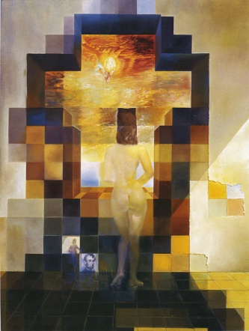
Next class: Light and Color and Thinking in Frequency

